Slide 1
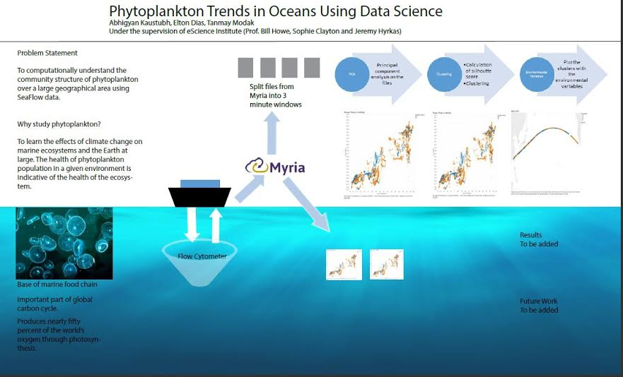
Add some background color. I would try to find a more interesting Font for the title
Try to better manage this space. The columns w/info to the left don’t need to be aligned
I will add a contrasting color, maybe similar to the one you used as background color in the main title. Don’t use more blue
I wouldn’t add a title to the section and I will instead include a cool image of phytoplankton with an interesting fact related!
I would enlarge this section and definitely, play with the size, color and style of the Font used in the question stated.
Change the Font, use another style or color
I will make this logo bigger
This is super important!!! I will enlarge it and again, change size, color and style of the Font of the title
For ideas of color combinations: http://colorpalettes.net/
Great Background!
Anything special for this section?

